Slide 1

ENGINEERING CHEMISTRY
Asha A
Department of Science and Humanities

Slide 2

ENGINEERING CHEMISTRY
Module 6- Corrosion Chemistry
Module content:
Electrochemical Theory of corrosion
Types of corrosion
Factors affecting rates of corrosion
Corrosion control

Slide 3
ENGINEERING CHEMISTRY
Module 6- Corrosion Chemistry
Class content:
Corrosion
Types of corrosion
Electrochemical Theory of corrosion
Corrosion of Iron

Slide 4
ENGINEERING CHEMISTRY
Module 6- Corrosion Chemistry
Corrosion
The destruction or deterioration & consequent loss of metal
through direct chemical or electrochemical attack by the
environment
Most metals except very noble ones, corrode on contact with
water (and moisture in the air), acids, bases, salts, oils,
aggressive metal polishes, and other solid and liquid
chemicals
Spontaneous process
Causes indirect losses

Slide 5
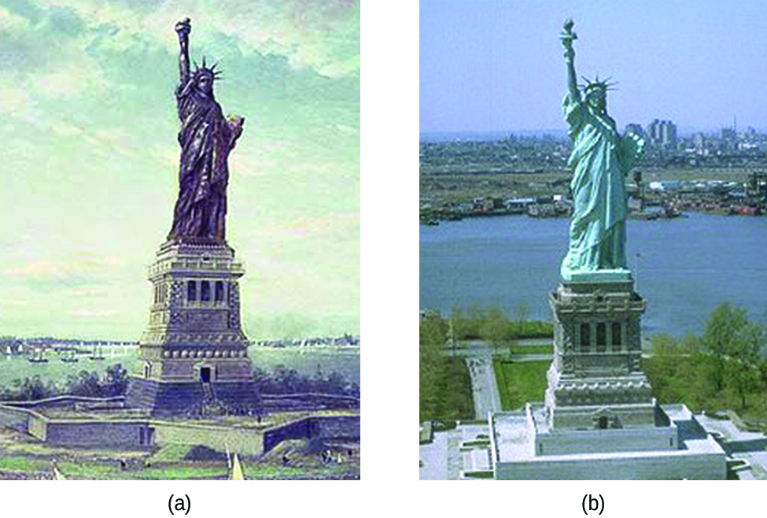
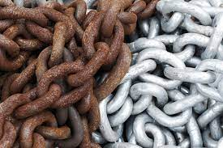
ENGINEERING CHEMISTRY
Module 6- Corrosion Chemistry
Pure metal → undesirable products
Rusting of iron - a reddish brown scale formation on iron and steel objects
Due to formation of hydrated ferric oxide (Fe₂O₃.xH₂O)
Scaling of Copper - Green scales formed on copper articles
Due to formation of basic cupric carbonate(CuCO₃ + Cu(OH)₂)
The Statue of Liberty is covered with a copper skin, and was originally brown, as shown in this painting
Exposure to the elements has resulted in the formation of the blue-green patina seen today
Source:https://opentextbc.ca/chemistry/chapter/17-6-corrosion/

Slide 6
ENGINEERING CHEMISTRY
Module 6- Corrosion Chemistry
Why do metals undergo corrosion?
Most metals occur in nature in the form of their compounds such as oxides, sulfides, carbonates, chlorides
Metals are extracted from these ores by reduction which is an endothermic process, energy being supplied in the form of heat or electrical energy
Pure metals are relatively at higher energy state compared to their corresponding ores, and they have a natural tendency to revert back to their combined state
Mineral (metal ore)
Corrosion
Spontaneous process
Extraction
Endothermic process
Metal

Slide 7
ENGINEERING CHEMISTRY
Module 6- Corrosion Chemistry
Types of corrosion
Dry corrosion :
Direct chemical attack due to affinity of the metal to certain gases
In the absence of the electrolytic medium
gases(O₂,F₂,H₂S,NH₃)
Wet corrosion :
Electrochemical attack on the metal
in the presence of moisture or conducting medium
M
Conducting medium
M

Slide 8
ENGINEERING CHEMISTRY
Module 6- Corrosion Chemistry
Electrochemical theory of corrosion
A large number of tiny galvanic cells are formed due to the formation of separate anodic and cathodic regions on the metal surface
At the anodic region, metal undergoes oxidation and gets converted into its ions, liberating electrons and the metal undergoes corrosion
At the cathodic region, reduction takes place but since the metal cannot be reduced further, metal atoms are unaffected by corrosion
Anode
Cathode
M
M → M^{n+} + ne⁻
A + ne⁻ → A^{n-}

Slide 9
ENGINEERING CHEMISTRY
Module 6- Corrosion Chemistry
The electrons liberated at the anodic region migrate to the cathodic region constituting a small corrosion current
The metal ions formed at the anode and some anions formed at the cathode diffuse towards each other through the conducting medium and form a corrosion product somewhere between anode and the cathode
Corrosion of metal continues as long as both anodic and cathodic reactions take place simultaneously
Anode
Cathode
M
e-
M → M^{n+} + ne⁻
A + ne⁻ → A^{n-}
Corrosion product

Slide 10
ENGINEERING CHEMISTRY
Module 6- Corrosion Chemistry
Reactions:
Anode:
M→ M^{n+} + ne⁻
e.g., when iron undergoes corrosion,
Fe → Fe²⁺+2e⁻
Cathode:
Liberation of hydrogen
Absorption of oxygen

Slide 11
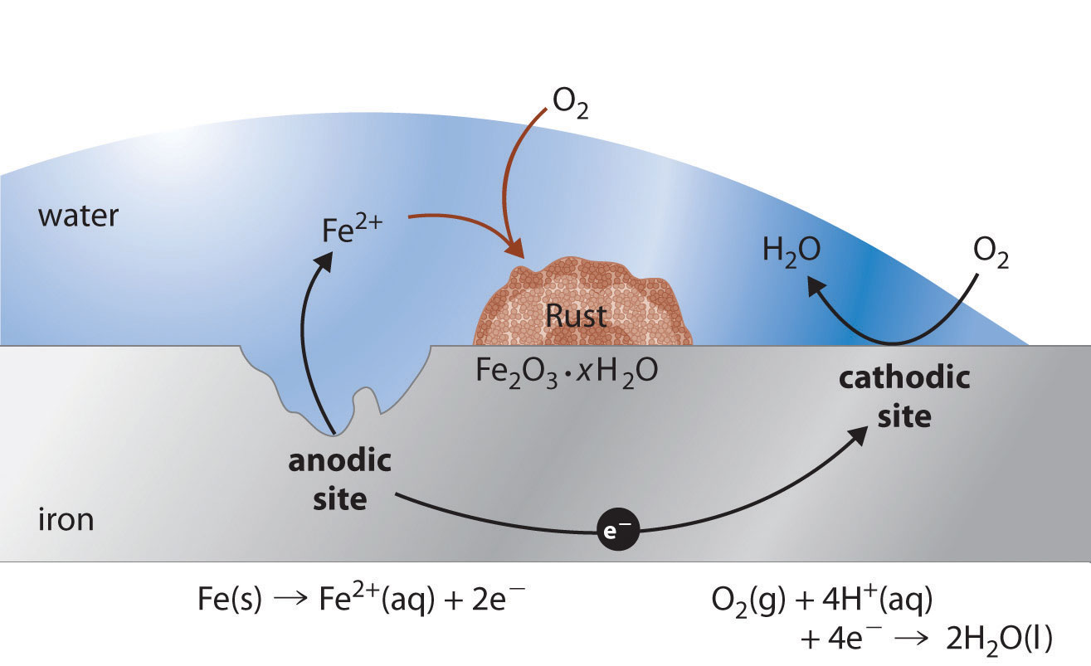
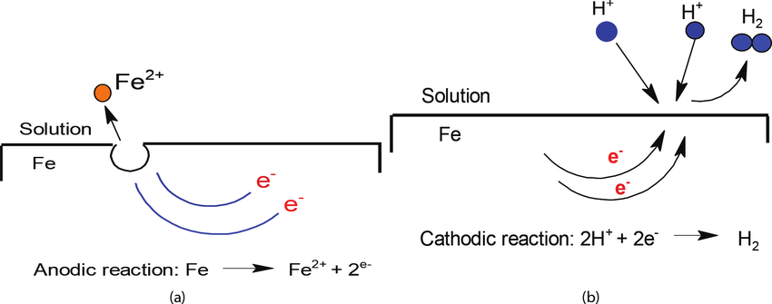
ENGINEERING CHEMISTRY
Module 6- Corrosion Chemistry
Liberation of hydrogen
In acidic medium
2H⁺+2e⁻→H₂↑
In neutral or alkaline medium
2H₂O+2e⁻→2OH─+H₂↑
Absorption of oxygen
In acidic medium
4H⁺ + O₂ + 4e⁻ → 2H₂O
In neutral or alkaline medium
2H₂O + O₂ + 4e⁻ →4OH⁻
https://www.google.com/url?sa=i&url=https%3A%2F%2Fwww.researchgate.net%2Ffigure%2Fa-Anodic-reaction-and-b-cathodic-reaction-in-metal-solution-interface_fig1_328509465&psig=AOvVaw1xlBgC2flXAGjR6trvtZs2&ust=1673455185168000&source=images&cd=vfe&ved=0CBEQjhxqFwoTCLD868W4vfwCFQAAAAAdAAAAABAP

Slide 12
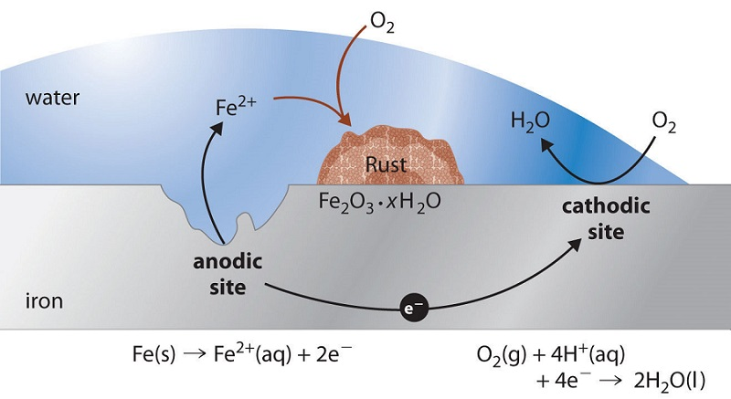
ENGINEERING CHEMISTRY
Module 6- Corrosion Chemistry
Corrosion of Iron:
Source: https://chem.libretexts.org/Bookshelves/General_Chemistry/Book%3A_Chem1_(Lower)/16%3A_Electrochemistry/16.08%3AElectrochemical_Corrosion
Anode : Fe → Fe²⁺+2e⁻
Cathode : 2H₂O + O₂ + 4e⁻ →4OH⁻
Fe²⁺ and OH⁻ ions move towards one another and Fe(OH)₂ is formed
somewhere between anode and cathode regions
2Fe²⁺ + 4OH⁻ → 2Fe(OH)₂

Slide 13
ENGINEERING CHEMISTRY
Module 6- Corrosion Chemistry
In an oxidizing environment, Fe(OH)₂ is oxidized to hydrated ferric oxide and is known as yellow rust
4Fe(OH)₂ + O₂ + 2H₂O → 2[Fe₂O₃.3H₂O]
Yellow rust
In the presence of limited oxygen, 4Fe(OH)₂ is converted into magnetic oxide of iron (Fe₃O₄) and is known as black rust
3Fe(OH)₂ +1/2 O₂ →Fe₃O₄.3H₂O
Black rust

Slide 14
THANK YOU
Asha A
Department of Science and Humanities

